Slide 1


3rd Party Access
Emilio Dunn, Solutions Engineer
Jeff Ostermiller, Principal Architect
James Marshall, Account Executive
Feb 20, 2025

Slide 2
Table of Contents
Executive Summary
Visual Roadmap - Simplified proxy control with Zscaler
Architecture Diagrams
Investment

Slide 3
Executive Summary
Key Benefits: Decrease costs and improve security controls for 3rd parties communicating with
Consistent Security & Streamlined Compliance: By replacing the CVS extranet with the Zscaler’s Extranet it will provide CVS with consistent security policy and streamlined compliance reporting.
Immediate Cost Reduction: Reduce CVSH’s operational costs associated the the 3rd party extranet through a centrally managed Extranet solution by extenting Zscaler’s Zero Trust Networking to the Extranet.
Customers need to connect to Business Partners Data Center to access private resources.
Current solutions require compromise of zero trust principles while imposing a significant operational overhead for extranet partners.

Slide 4







Zero Trust Foundation For Digital Transformation
Oak Street
Signify
+
10k
10k
VPN Users:
Non-VPN Users:
Scenarios:
Data Analytics
M&A
Contractor
B2B
130k
?
Digital Experience
Business Insights
Risk360
Vuln Mgmt
Corporate Colleagues
Unified Security Foundation
3rd Party User Access
Increase Speed to Connectivity
Remove Colleague Network Access via Direct to App
Decommission Legacy Technologies
100K+ employees
DLP
DNS Security
Plugin Control
Advanced Threat Protection
Granular Controls and Visibility for 3rd Party System Access
Eliminate Dual Laptop for M&A
Displace VDI/Citrix Costs (ramp time)
Tenant Restriction
URL Filtering
CASB
User Experience Monitoring
Network Fault Detection
FTP Control
Sandbox
Security Alerting
Browser Isolation
IPS
App Protection
Sites:
DSPM
App Segmentation
Stores:
Identity Proxy
Cloud Firewall
Browser Access
900
Malware Protection
Privileged Remote Access
Workflow Automation
SSL Inspection
3.1k
DNS Control
ZTNA
Cloud App Control
SSPM
Remote Sites
Retail Locations
ZT SD-WAN: Transition Next Gen Sites (10) + Hub & Spoke Sites (890)
Develop best path to Zscaler for Internet and Private Application Access
Improved Colleague Experience
Egress Protection:
Private Access:
Egress Protection:
Private Access:
Internet Egress from Retail Locations – 6,781
Align with Omni-channel Strategy
Eliminate Single Point of Failure
Beginning Production Design Workshop
GCP
Azure
AWS
GCP
Azure
AWS
AZ
CT
RI
AZ
CT
RI
Cloud Service Providers
Physical Datacenters
Accelerate Adoption of Zero Trust Principles
GCP design and configuration plan to test in progress
Azure and AWS preliminary plan for design and configuration to test
Accelerate Adoption of Zscaler for Egress Protection
Increase Colleague Experience and Performance
Decommission Legacy Technologies
Zscaler Enabled
Future

Slide 5
Zero Trust Foundation For Digital Transformation
+
VPN Users:
ZPA
Data Analytics
3rd Party User Access
130k
ZPA
Digital Experience
Business Insights
Granular Controls and Visibility for 3rd Party System Access
Eliminate Dual Laptop for M&A
Displace VDI/Citrix Costs (ramp time)
Risk360
Vuln Mgmt
Corporate Colleagues
Unified Security Foundation
Increase Speed to Connectivity
Remove Colleague Network Access via Direct to App
Decommission Legacy Technologies
100K+ employees
DLP
DNS Security
Plugin Control
Advanced Threat Protection
Tenant Restriction
URL Filtering
CASB
User Experience Monitoring
Network Fault Detection
FTP Control
Sandbox
Security Alerting
Browser Isolation
3rd Party Server Access
IPS
App Protection
Sites:
DSPM
App Segmentation
Granular Controls and Visibility for 3rd Party System Access
Eliminate Dual Laptop for M&A
Displace VDI/Citrix Costs (ramp time)
Identity Proxy
Cloud Firewall
Browser Access
900
Malware Protection
Privileged Remote Access
Workflow Automation
SSL Inspection
DNS Control
ZTNA
Cloud App Control
SSPM
Stores:
Remote Sites
ZT SD-WAN: Transition Next Gen Sites (10) + Hub & Spoke Sites (890)
Develop best path to Zscaler for Internet and Private Application Access
Improved Colleague Experience
Egress Protection:
Private Access:
Egress Protection:
Private Access:
3.1k
GCP
Azure
AWS
GCP
Azure
AWS
AZ
CT
RI
AZ
CT
RI
Retail Locations
Internet Egress from Retail Locations – 6,781
Align with Omni-channel Strategy
Eliminate Single Point of Failure
Beginning Production Design Workshop
Cloud Service Providers
Physical Datacenters
Accelerate Adoption of Zero Trust Principles
GCP design and configuration plan to test in progress
Azure and AWS preliminary plan for design and configuration to test
Accelerate Adoption of Zscaler for Egress Protection
Increase Colleague Experience and Performance
Decommission Legacy Technologies

Slide 6
CVS Use Cases
Isolating partner networks from all other partner networks
Isolating partners from CVS network via the zero trust principals
CVS Employee using ZPA to connect to partner applications
Server in CVS connecting to servers in partner servers
Server or user in Partner environment connecting to server in CVS Network

Slide 7




Challenges Connecting to Business Partner’s Private Apps
Extending IPsec to Business Partner DC
Data Center
Routers in HA mode
Business Partner’s DC
Data Center
Challenges - High Availability
IPSec Tunnel
Link failure
Site Failure
Data Center
Equipment Failure
Roaming ZPA user

Slide 8

Challenges Connecting to Business Partner’s Private Apps
Extending IPsec to Business Partner DC
Data Center
HSRP Failure/Equipment failure
Business Partner’s DC
Data Center
Challenges - High Availability
Standby router establishes a new IPSec tunnel
Link failure
Site Failure
Data Center
Equipment Failure
Operational Complexity
Service disruption due to stateless failover
Roaming ZPA user

Slide 9

Challenges Connecting to Business Partner’s Private Apps
Corporate DC 1
Extending IPsec to Business Partner DC
Data Center
Acme.corp Chennai
Challenges - High Availability
Link failure
Acme.corp Mumbai
Site Failure
Full mesh of Active/Passive
Tunnel
Equipment Failure
Site Failure - Partner
Data Center
Globex.corp Delhi
Globex.corp Hyderabad
Corporate DC 2
IPSec Tunnels
Roaming ZPA user

Slide 10
Challenges Connecting to Business Partner’s Private Apps
Corporate DC 1
Tunnel to Acme.corp Chennai fails
Site Failure
Extending IPsec to Business Partner DC
Data Center
Acme.corp Chennai
Challenges - High Availability
Link failure
Acme.corp Mumbai
Site Failure
Switch IPSec to Acme.corp Mumbai DC
Equipment Failure
Site Failure - Partner
Data Center
Globex.corp Delhi
Operational Complexity
Globex.corp Hyderabad
Managing the scale of redundant tunnel to different partner data centers
Corporate DC 2
IPSec Tunnels
Roaming ZPA user

Slide 11
Challenges Connecting to Business Partner’s Private Apps
Corporate DC 1
Extending IPsec to Business Partner DC
Data Center
Application failure
sap.acme.corp
Challenges - High Availability
Acme.corp Chennai
Link failure
sap.acme.corp
Site Failure
SLA monitor cannot discover application failure, manual failover to secondary DC
Equipment Failure
Acme.corp Mumbai
Site Failure - Partner
Data Center
Application Failure
Operational Complexity
Corporate DC 2
Manual failover needed
Service Disruption
Roaming ZPA user

Slide 12
Challenges Connecting to Business Partner’s Private Apps
Extending IPsec to Business Partner DC
Data Center
Security Audit recommends to latest cipher suite
Challenges - High Availability
Banking Partner
Link failure
Data Center
Site Failure
Equipment Failure
Data Center
Site Failure - Partner
Application Failure
Compliance requirements
Roaming ZPA user

Slide 13
Challenges Connecting to Business Partner’s Private Apps
Extending IPsec to Business Partner DC
Data Center
Challenges - High Availability
Banking Partner
Link failure
Data Center
Site Failure
Obsolete hardware requires upgrade to meet the compliance
Equipment Failure
Data Center
Site Failure - Partner
Application Failure
Compliance requirements
Operational Complexity
Immediate procurement of additional hardware
Service disruption to other partners during hardware change
Roaming ZPA user

Slide 14



Introducing Extranet Application Support
Corp Data Center
Data Center
Seamlessly connect to Business Partner’s Private Apps using existing connectivity paradigms
Zero trust extranet access
Business partner’s Private Apps
IPsec Tunnel to Zero Trust Exchange
Works with Zscaler Private Access
acme.corp
Data Center
IPSec Tunnels to ZTE
Zscaler managed
Scaling Complexity
Routing Complexity
IPSec Management
DNS Forwarding Complexity
ZPA user

Slide 15
Branch connectivity as a service
Corp Data Center
Data Center
Branch
Seamlessly connect to Branches to secure internet and private apps
Provides remote connectivity into branches
No need to deploy any component within the branch.
IPSec Tunnels to ZTE
Roaming ZPA user

Slide 16

Extranet Application Support - Location Aware Routing
ZPA User in Corporate Office , can access acme.corp resources via Chennai Node (Location Proximity)
Active-Active Tunnels to regional IPSec node
Chennai IPSec Node
acme.corp
Advantage
Shortest path to application access.
Location aware path selection
Corporate Office (Bengaluru)
Data Center
Delhi IPSec Node
Business Partner Data Center
User working from home, can access globex.corp resources via Delhi Node (Location Proximity)
ZPA User working from Home (Delhi)

Slide 17
Extranet Application Support - High Availability
ZPA User in Corporate Office , want to access resources on acme.corp
Active-Active Tunnels to regional IPSec node
Chennai IPSec Node
acme.corp
Corporate Office (Bengaluru)
Data Center
Delhi IPSec Node
Business Partner Data Center
User working from home, can access globex.corp resources via Delhi Node (Location Proximity)
ZPA User working from Home (Delhi)

Slide 18
Extranet Application Support - High Availability
ZPA User in Corporate Office , want to access resources on acme.corp
Chennai IPSec Node
acme.corp
Corporate Office (Bengaluru)
IPSec Tunnel fails
Data Center
Delhi IPSec Node
Business Partner Data Center
User working from home, can access globex.corp resources via Delhi Node (Location Proximity)
ZPA User working from Home (Delhi)

Slide 19
Extranet Application Support - High Availability
Continued access via active Delhi IPsec tunnel
Chennai IPSec Node
acme.corp
Corporate Office (Bengaluru)
IPSec Tunnel fails
Data Center
Delhi IPSec Node
Business Partner Data Center
Advantage
User working from home, can access globex.corp resources via Delhi Node (Location Proximity)
Seamless failover to alternate path.
ZPA User working from Home (Delhi)
No administrative overhead

Slide 20
Extranet Application Support - High Availability
Partner initiates IPSec Connection towards Load balancer
Load Balancer forwards traffic to IPSec node
acme.corp
Data Center
Load Balancer
Business Partner Data Center

Slide 21
Extranet Application Support - High Availability
If IPSec node fails
acme.corp
Data Center
Advantage
High Availability in Zero Trust Exchange
Load Balancer
Load Balancer forwards the traffic to other IPSec node
Business Partner Data Center

Slide 22

Use Case 1: CVS Users Accessing Partner Resources
Corp Data Center
Data Center
Partner DC
Data Center
IPSec Tunnels to ZTE
ZPA Users
Partner creates IKEv2 IPSEC tunnel to the closest Zscaler Data Center
Seamlessly connect to Business Partner’s Private Apps using existing connectivity paradigms
Zero trust extranet partner access enabled via Zscaler Client Connector

Slide 23

Use Case 2: CVS Servers Accessing Partner Resources
Corp Data Center
Data Center
IaaS Data Center
Partner DC
IAAS
Data Center
IPSec Tunnels to ZTE
ZPA Users
Partner creates IKEv2 IPSEC tunnel to the closest Zscaler Data Center
Seamlessly connect to Business Partner’s Private Apps using existing connectivity paradigms
Zero trust extranet partner access enabled via Zscaler Branch/Cloud Connector

Slide 24
Use Case 3: Partner Accessing CVS Resources
Corp Data Center
Data Center
IaaS Data Center
Partner DC
IAAS
Data Center
IPSec Tunnels to ZTE
CVS ZPA Users
Partner creates IKEv2 IPSEC tunnel to the closest Zscaler Data Center
Seamlessly connect to Business Partner’s Private Apps using existing connectivity paradigms
Zero trust extranet partner access enabled via Zscaler Branch/Cloud Connector

Slide 25
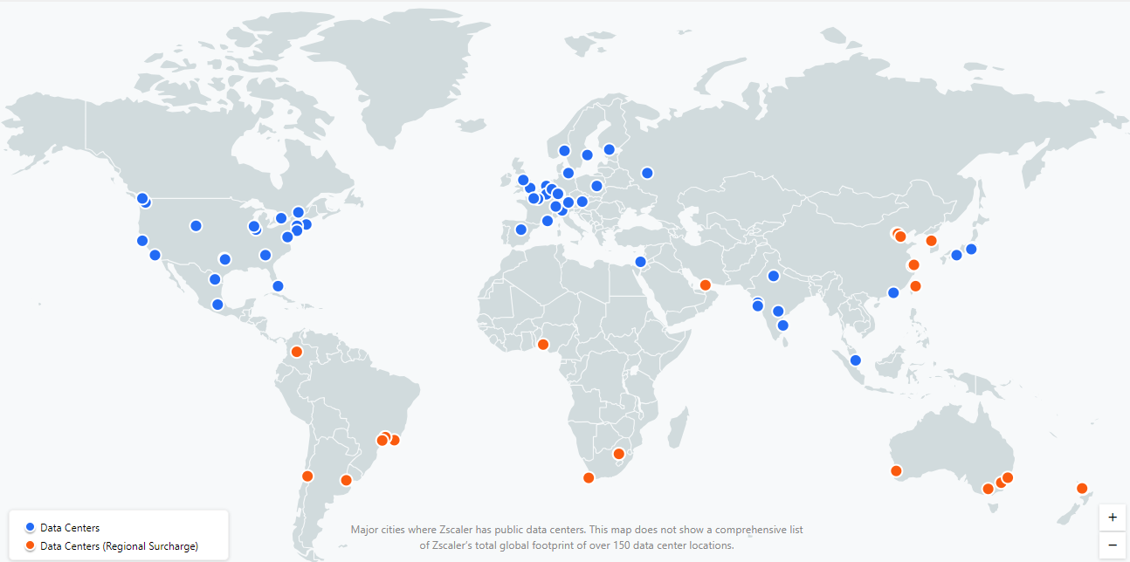
Extranet Application Support - Global Presence & rigorous security standards
Advantage
Global footprint of more than 150 datacenter location
Adherence to rigorous security, availability and privacy standards.
Refer to below link to access global commercial and global government certifications
https://www.zscaler.com/compliance/overview

Slide 26
Technical Details

Slide 27
Life of a Packet

Slide 28
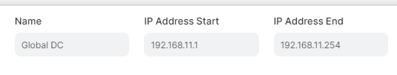

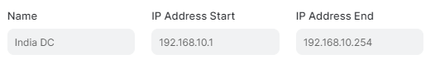
IPSec Establishment
2. Configured traffic selector for Location A
Partner Acme.corp initiates IKEv2 tunnel to ZTE from Location A
IPSEC SA for Location A
192.168.11.12 – Lan of Location A
3. Assigned IP address 192.168.11.12
Acme.corp Location A
3. Assigned IP address 192.168.10.2
IPSEC SA for Location B
192.168.10.2 – Lan of Location B
Partner Acme.corp initiates IKEv2 tunnel to ZTE from Location B
2. Configured traffic selector for Location B
Acme.corp Location B

Slide 29
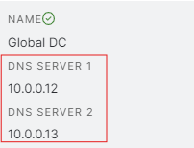



DNS & Data Path Flow
Configured traffic selector for Location
The DNS request is forwarded to the extranet-configured DNS server for resolution
User can access sap.acme.corp via IPSec
Business Partner’s DC
LAN Subnet 10.0.0.0/24
IPSec to ZTE
Sap.acme.corp is 10.0.0.20
Source IP - 192.168.11.12 Destination IP - 10.0.0.20
Source IP - 192.168.11.12 Destination IP - 10.0.0.12
Assigned IP address 192.168.11.12
DNS Server
The traffic is source nated to the assigned IP 192.168.11.12
ZTE validates Access policy
acme.corp
IPSEC SA for Location
192.168.11.12 – 10.0.0.0/24
ZPA User wants to access application sap.acme.corp

Slide 30
ZIA and Extranet App Support

Slide 31
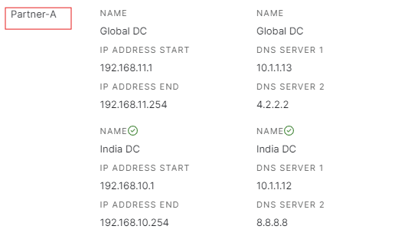
Extranet
Each Extranet entity represents unique a business partner.
Each Extranet needs two mandatory configurations which will be used further which are Traffic Selectors and DNS servers.
Upto 16 Traffic Selectors and DNS servers can be configured per Extranet.
Traffic Selector
Traffic selector is a range of IP addresses assigned to an Extranet. Each unique IPSec tunnel is assigned an IP address from the range.
DNS Server
The business partner’s DNS server which will be used to resolve FQDN of application to IP.
Can be both public and private.
Should be accessible via IPSec tunnel to Partner

Slide 32
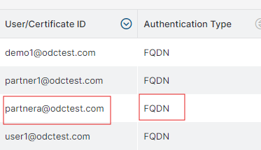
VPN Credentials
Placeholder for configuring all IPSec credentials for all the Extranets.
Only FQDN based pre-shared keys are supported.
IP based pre-shared keys are not supported for the feature.
FQDN based pre-shared key means that Zscaler will look for a pre-shared key in its database only when the partner sends an FQDN in its IKE-ID field instead of IP. The default behaviour of many VPN appliances is to send IKE-ID as IP.
The connectivity will still be IP based, the partners do not have configure FQDN as the IPSec peer.
Only IKEv2 based tunnels are supported. No support for IKEv1.

Slide 33
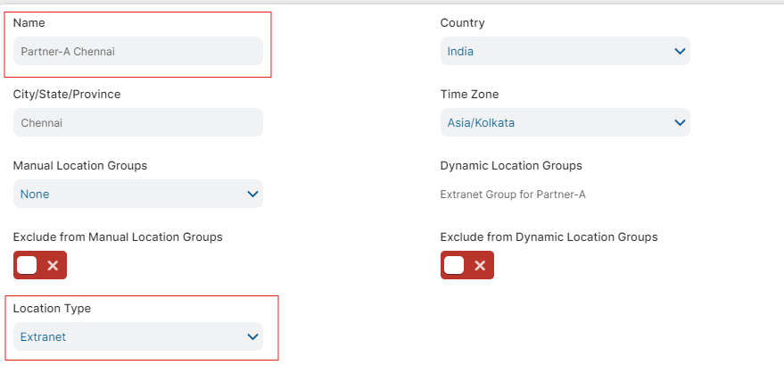
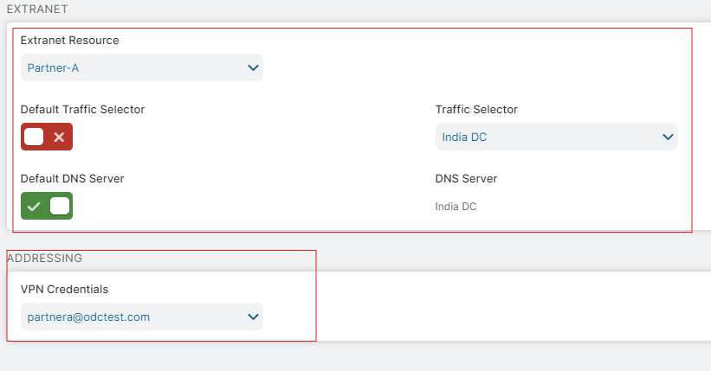
Location
Unifies all the configuration done on the ZIA Admin Portal for an Extranet Resource.
Represents each Business Partner’s location from where an IPSec tunnel is build.
Mandatory Configuration
Location Type - Selecting location type to Extranet , changes the Location configuration i.e the location now becomes Extranet Location instead of ZIA Location.
Extranet Resource - Represents the name of the business partner the location will be used for.
Traffic Selector - Either default traffic selector marked in the Extranet Location can be selected or a traffic selector from a drop down list.
DNS Server - Either default DNS server marked in the Extranet Location can be selected or a DNS Server from a drop down list.
VPN Credentials - The IPSec pre-shared key that will be used by Partner to build tunnel to ZTE.

Slide 34
Bridging Extranet Resource, VPN credential, Location and Location groups.
Extranet Resource acme.corp
Location A
Traffic Selector A
DNS Server A
Traffic Selector B
DNS Server B
Traffic Selector A
DNS Server A
VPN Credential A
Location group acme.corp
Same extranet location mapped to
VPN Credentials
Location B
VPN Credential A
VPN Credential B
Traffic Selector B
DNS Server B
VPN Credential B

Slide 35
ZPA and Extranet App Support

Slide 36
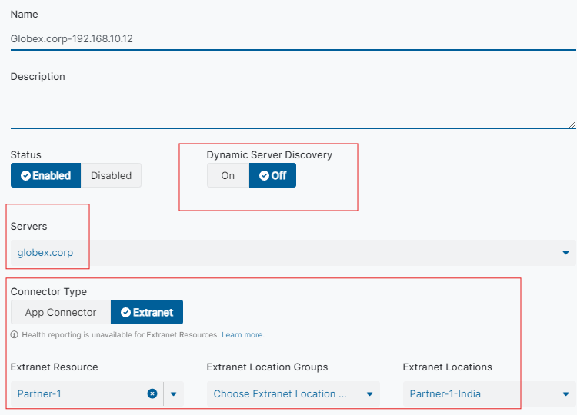
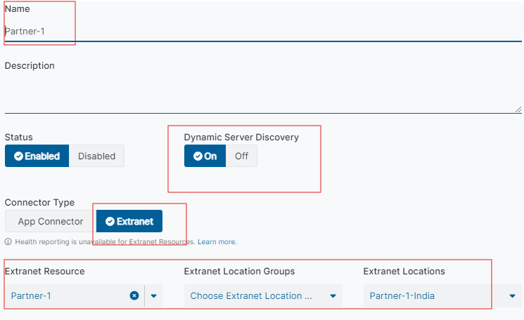
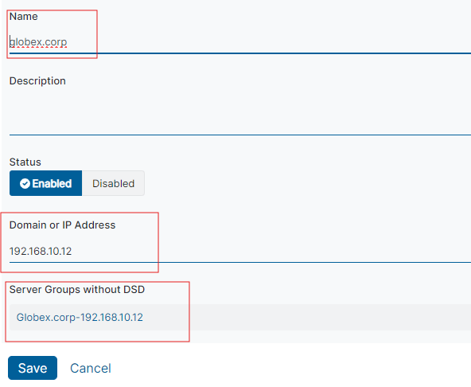
Server Group and Server
Server Group (Dynamic Discovery ON)
IP resolution for an application will be done via the configured DNS server on the Extranet Location at the time of access.
Server Group (Dynamic Discovery OFF)
IP resolution for an application cannot be done via configured DNS server, rather IP of an FQDN or a translation of configured IP in the application segment is hard coded on the server definition .
Server
Explicitly define IP address for Static FQDN to IP OR IP to IP mapping.
Server group (Dynamic Discovery ON)
Server group (Dynamic Discovery OFF) with server mapping

Slide 37
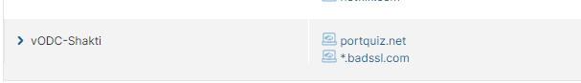
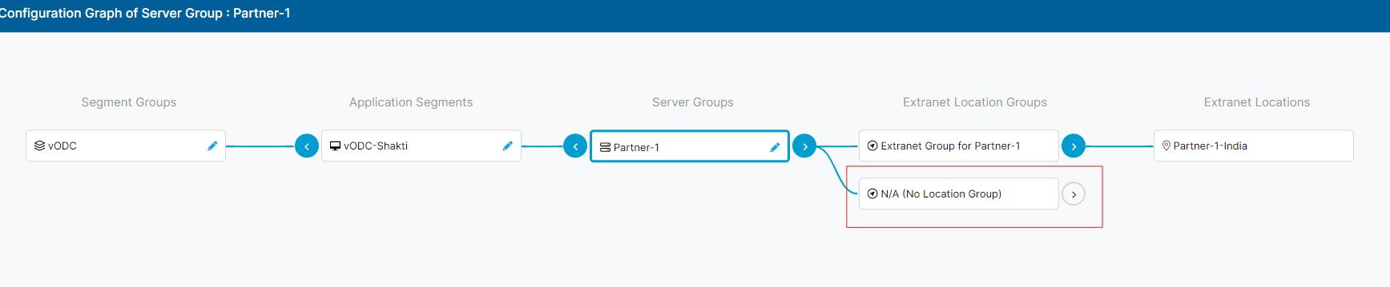
Application Segment
An application segment is a grouping of defined applications, based upon access type or user privileges
Defining your applications in application segments enables you to:
Restrict access to excess ports for the application, reducing the application’s attack surface.
Leverage those application segments in access policies to restrict user groups that can access them, as well as reduce lateral movement.
In the context of Extranet , an administrator would create an application segment and map it to a server group, which is mapped to an Extranet resource, Extranet Location.

Slide 38
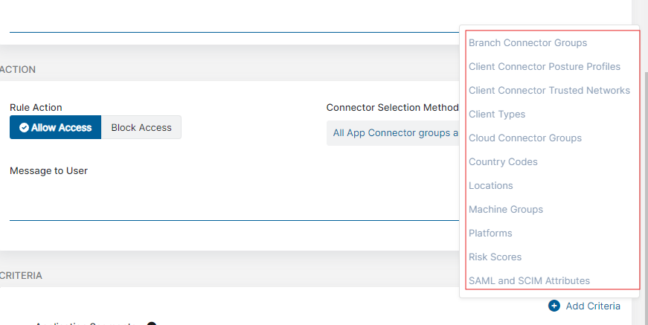
Access Policy
Access policy rules enable you to implement role-based access control
Access policy rules provide the following benefits and enable you to:
Implement role-based access control to your application segments or segment groups.
Use additional criteria to restrict access based on device posture profile conditions, trusted networks, client types, Cloud Connector Groups, Machine Groups, and SAML or SCIM attributes.

Slide 39
Bridging Application Segment, Server Group and Extranet Location or Location group
Server group with Dynamic Discovery Off
Server and Extranet Location or Location Group
Static FQDN to IP or IP to IP Mapping
Mapped to
Application Segment
FQDN to IP resolution via DNS configured on Extranet Location
Server group with Dynamic Discovery ON
Extranet Location or Location Group
Mapped to

Slide 40
Deployment

Slide 41
Active-Active IPSec tunnels with failover
Active Tunnel 1
Active Tunnel 2
Traffic Selector configured for acme.corp
Standby Tunnel 1
192.168.10.1 - 192.168.10.254
172.16.12.1 - 172.16.12.254
Standby Tunnel 2
Business Partner DC
Chennai IPSec Node
acme.corp
IPSEC
LAN 10.0.0.0/24
Mumbai IPSec Node
Tunnel 1 with failover to Standby Tunnel 1
Crypto acl - 10.0.0.0/24 - 192.168.10.0/24
Set IPSec Peer as Chennai VIP and Backup as Mumbai VIP
Route - 192.168.10.0 255.255.255.0 <Default GW> track (track ID of SLA)
Tunnel 2 with failover to Standby Tunnel 2
Crypto acl - 10.0.0.0/24 - 172.16.12.0/24
Set IPSec Peer as Chennai VIP and backup as Mumbai VIP
Route - 172.16.10.0 255.255.255.0 <Default GW> track (track ID of SLA)

Slide 42
Throughput above 400Mbps (Without NAT-T)
Traffic Selector configured for acme.corp
IPSec throughput is limited to 400 Mbps per Public IP
192.168.10.1 - 192.168.10.254
172.16.12.1 - 172.16.12.254
Business Partner DC
acme.corp
Chennai IPSec Node
ISP 1
DNS Server
IPSEC
ISP 2
LAN 10.0.0.0/24
ISP 1
Crypto acl - 10.0.0.0/24 - 192.168.10.0/24
IPSEC Peer - Chennai IPSEC VIP
Route - 192.168.10.0 255.255.255.0 <Default GW ISP1> track (track ID of SLA)
ISP 2
Crypto acl - 10.0.0.0/24 - 172.16.12.0/24
IPSEC Peer - Chennai IPSEC VIP
Route - 172.16.12.0 255.255.255.0 <Default GW ISP2> track (track ID of SLA)

Slide 43
Throughput above 400Mbps (With NAT-T)
Active Tunnel 1
Active Tunnel 2
Traffic Selector configured for acme.corp
192.168.10.1 - 192.168.10.254
172.16.12.1 - 172.16.12.254
Business Partner DC
acme.corp
IPSec Node
DNS Server
IPSEC Tunnel
IPSec router
Edge router configured with PAT rule for IPSEC peer
LAN 10.0.0.0/24
Active Tunnel 1
Crypto acl - 10.0.0.0/24 - 192.168.10.0/24
IPSEC Peer - IPSEC VIP
Route - 192.168.10.0 255.255.255.0 <Default GW>
Active Tunnel 2
Crypto acl - 10.0.0.0/24 - 172.16.12.0/24
IPSEC Peer - IPSEC VIP
Route - 172.16.12.0 255.255.255.0 <Default GW ISP2>

Slide 44
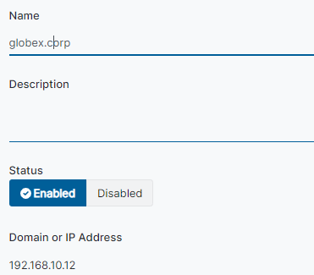
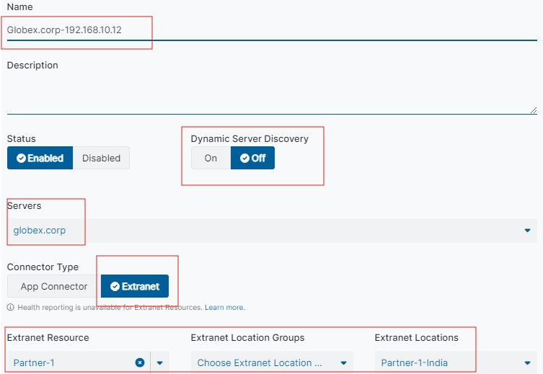
Overlapping IP Segments
FQDN nat to overlapping IP (access by FQDN)
Add a server with real IP address of the application.
Add a server group with Dynamic Discovery Off and select the previously configured server.
Select the connector type as Extranet and map it to Extranet resource , location or location group.
Configure application segment with a pseudo FQDN and map the previously configured server group.
Outcome - User will access the overlapping IP segment with a pseudo FQDN instead of real IP address.

Slide 45
Overlapping IP Segments
IP nat to overlapping IP (access by IP)
Add a server with real IP address of the application.
Add a server group with Dynamic Discovery Off and select the previously configured server.
Select the connector type as Extranet and map it to Extranet resource , location or location group.
Configure application segment with a pseudo IP address and map the previously configured server group.
Outcome - User will access the overlapping IP segment with a pseudo IP instead of real IP address.

Slide 46
Deployment Best Practices
Configure a complex pre-shared key should be upto 12 characters including a lower and upper case letter, a special character and a number.
Configure IPSec tunnel in HA.
Configure IPSec tunnel to nearest DC.
Always choose the strongest cipher from the list here .
Configure On-Demand Dead Peer Detection for IKEv2.
Access applications via FQDN, avoid IP based access.
Restrict application access to authorized identities.
Use a combination of SAML/SCIM attributes, Posture profiles and application segments to allow access to Extranet applications.
Choose a traffic selector which does not overlap with Partner’s DC.

Slide 47
Partner IPSec requirements
Firewall Whitelisting
UDP 500, UDP 4500 for IKE (Outbound towards IPSec Peer).
Extranet Traffic Selector IP Range (Inbound towards DNS Server and Applications) .
UDP 53 for DNS should be whitelisted sourcing inbound from Extranet Traffic selector IP range.
Preferably , all ports and protocols inbound towards applications should be allowed from
Extranet Traffic selector IP range.
IPSec Requirements
IPSec vendor should support IKEv2.
IPSec vendor should support configure IKE-ID as FQDN for IKEv2 Tunnel.
IPSec vendor should support the parameter mentioned here.
IPSec vendor should support pre-shared key authentication using IKEv2.
Volume based phase 2 rekey should be disabled.
On Demand- Dead Peer Detection should be enabled preferrably.
Traffic Selector Requirements
Minimum traffic selector of /20.
Traffic selector should not overlap with the selected partner LAN subnet causing routing issues.
The traffic selector IP should not be natted in the path.

Slide 48
Configuration

Slide 49
Configuration Overview
ZIA Configuration
Configuring Extranet.
Configuring VPN credentials.
Configuring Location Management.
Optionally configuring Location Groups.
ZPA Configuration
Configuring Server group of Type Extranet.
Mapping Application Segments to Extranet Type Server group.
Configuring Access Policies.

Slide 50
Configuration-ZIA

Slide 51
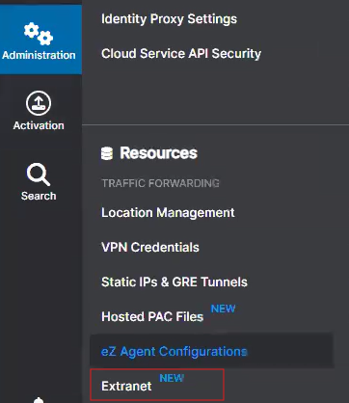
ZIA Configuration (Extranet)
Navigate - Administration > Resources > Extranet

Slide 52
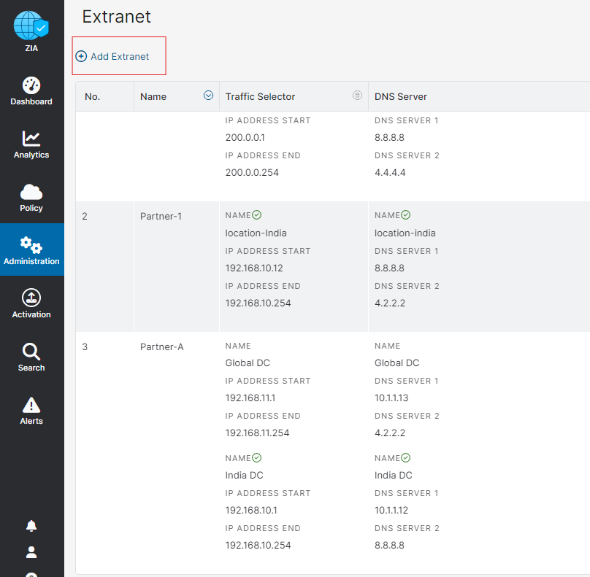
ZIA Configuration (Extranet)
Click on Add Extranet

Slide 53
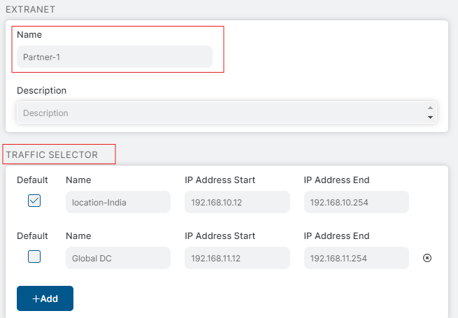
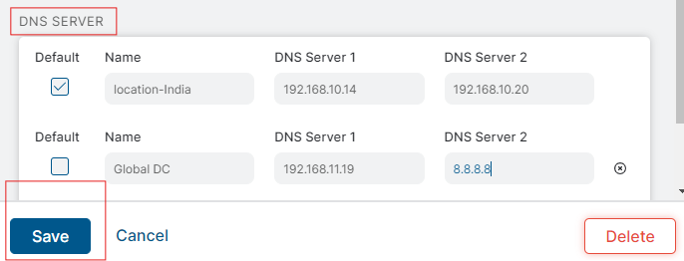
ZIA Configuration (Extranet)
Configure the name of Extranet (Partner’s name)
Configure the Traffic Selector upto 16 per extranet.
Configure the DNS server upto 16 per extranet.
Mark a default Pool and DNS server.
These pool ranges and dns servers when mapped to location can be used by Partner when configuring IPsec Tunnel.

Slide 54
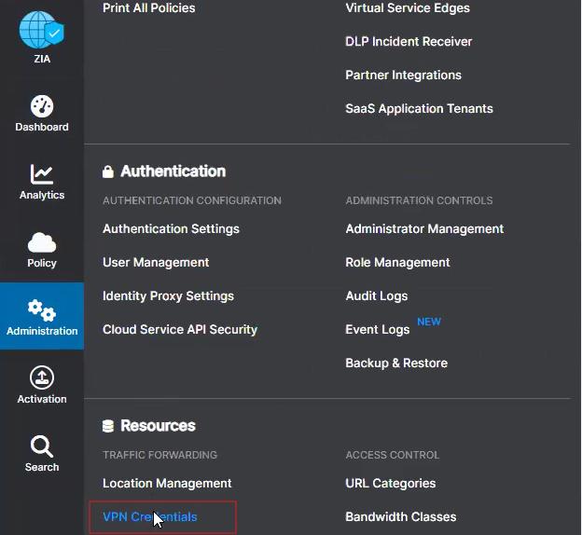
ZIA Configuration (VPN Credentials)
To add a VPN Credentials
Navigate to Administration>Resources>VPN Credentials.

Slide 55
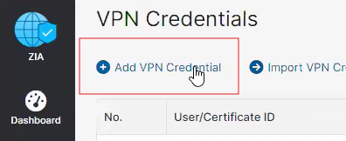
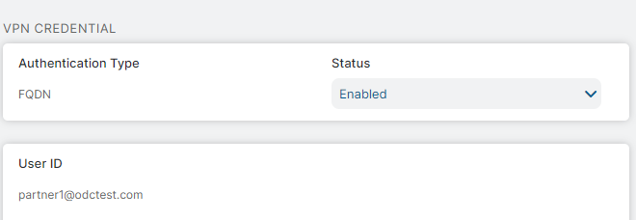
ZIA Configuration (VPN Credentials)
Click on Add VPN Credentials
Select the authentication type as FQDN
Enter a unique user ID (to be used in a location)
Enter a PSK and confirm. Click on Save.
Note - Only FQDN based credentials are supported, which requires the Initiator of the tunnel to set IKE-ID as the configured FQDN.

Slide 56
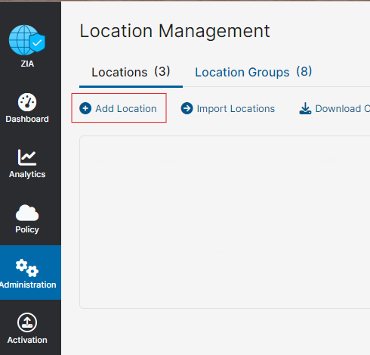
ZIA Configuration (Location Management)
Navigate - Administration >Resources >Location Management.
Click on Add Location.

Slide 57
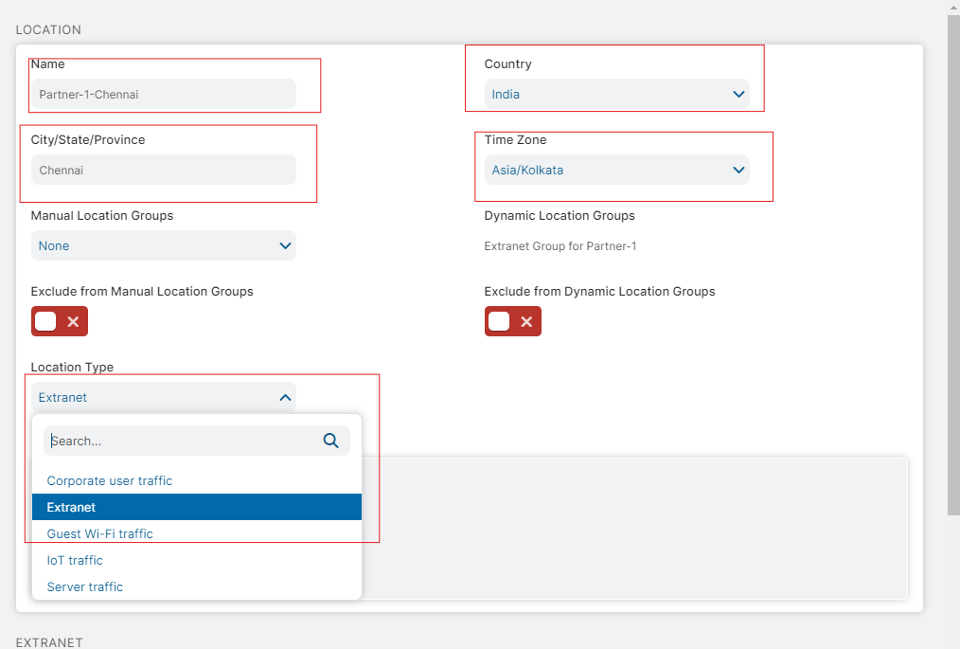
ZIA Configuration (Location Management)
Select the Location Type as Extranet

Slide 58
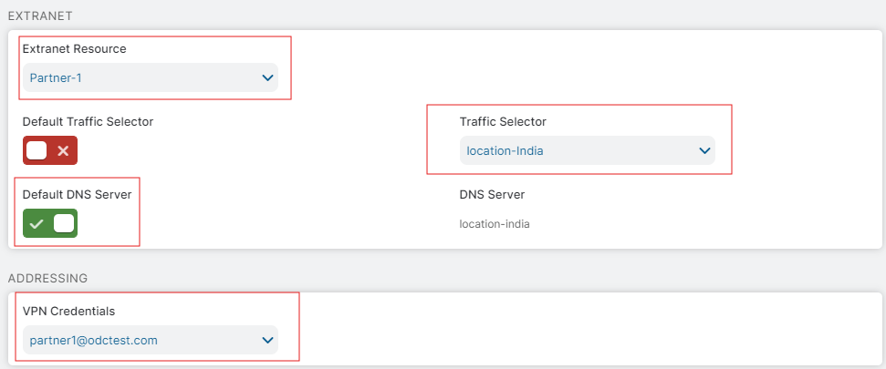
ZIA Configuration (Extranet)
On Selecting the Location type as Extranet, the ZIA location attributes will be removed.
Select the Extranet Resource of your choice.
Select a traffic selector.
Select a DNS server.
Optionally you can also use the default traffic selector or DNS server which will use the default marked pool or dns server configured in Extranet location.
Select the VPN Credentials for the location.
Fill the remaining mandatory fields such as Location name, timezone, etc. and save.

Slide 59
Configuration - ZPA

Slide 60
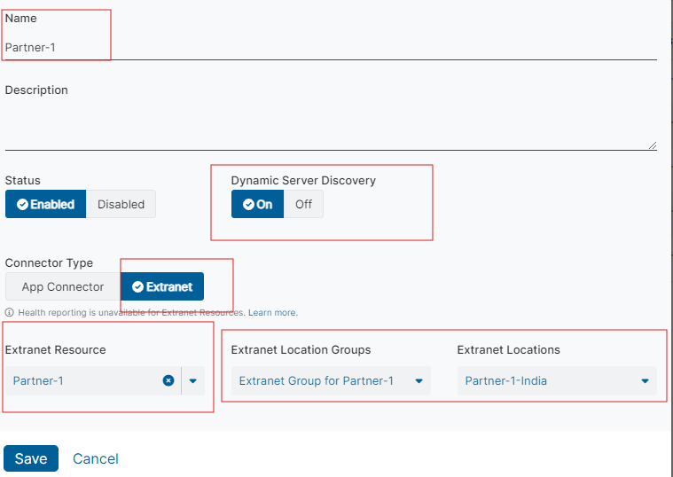
ZPA Configuration (Add a new server group)
Navigate to Configuration and Control>Private Infrastructure>App Connector Management > Server Group
Add Server Group
Give a name to Server Group
Select Connector Type as Extranet
Select an Extranet Resource (As configured on ZIA)
Select Extranet Locations or Extranet Location Groups.

Slide 61
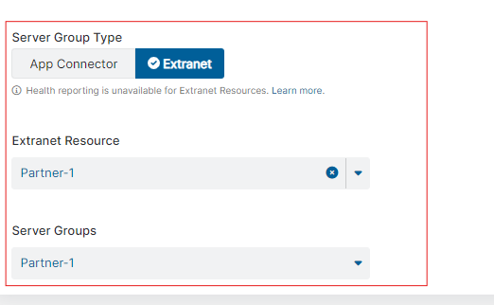
ZPA Configuration (Defining Application Segment)
Click on Resource Management>Application Segments and click on Add Application Segment
Define tha application segment
Configure the FQDN or IP of the application
Configure the TCP and UDP port range.
Disable Multi Match,ICMP, Source IP Anchoring,Double Encryption
Set Health Check to None.
Select Server group type as Extranet and select the server group as defined in previous step
Note- Applications cannot be mapped to both App Connector and Extranet based server group. Therefore unique application segments for Extranet applications should be defined, i.e not to be mixed with apps reachable via App Connector.

Slide 62
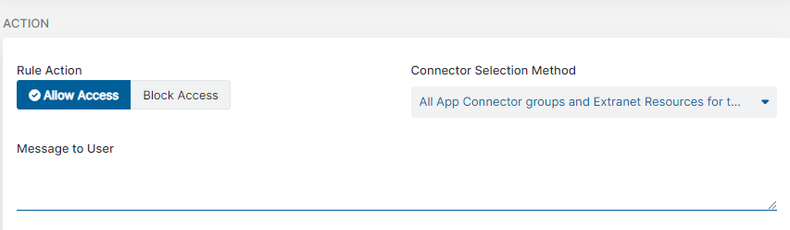
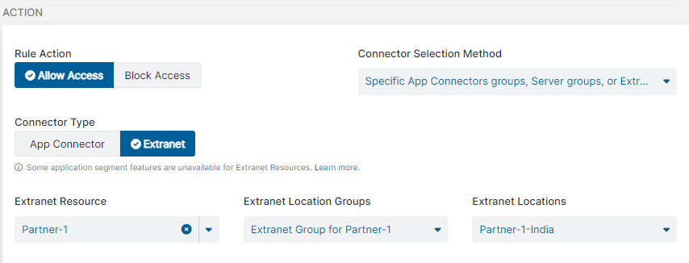
ZPA Configuration (Configuring Access Policy)
Navigate to Policy > Access Policy >.Add Rule
Select the action (Allow or Block Access)
Select the connector type as Extranet.
Select from the available options
a.) All extranet location for the application
b.) Specific Extranet Locations or Location groups for the application
Add criteria for the policy

Slide 63
Logging and Analytics

Slide 64
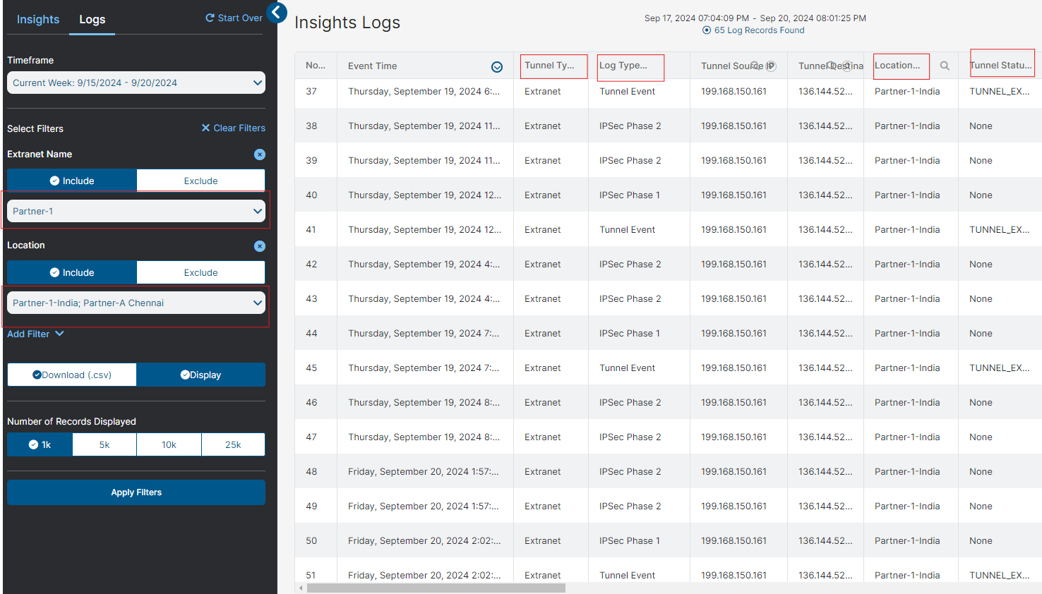
ZIA Tunnel Insights

Slide 65
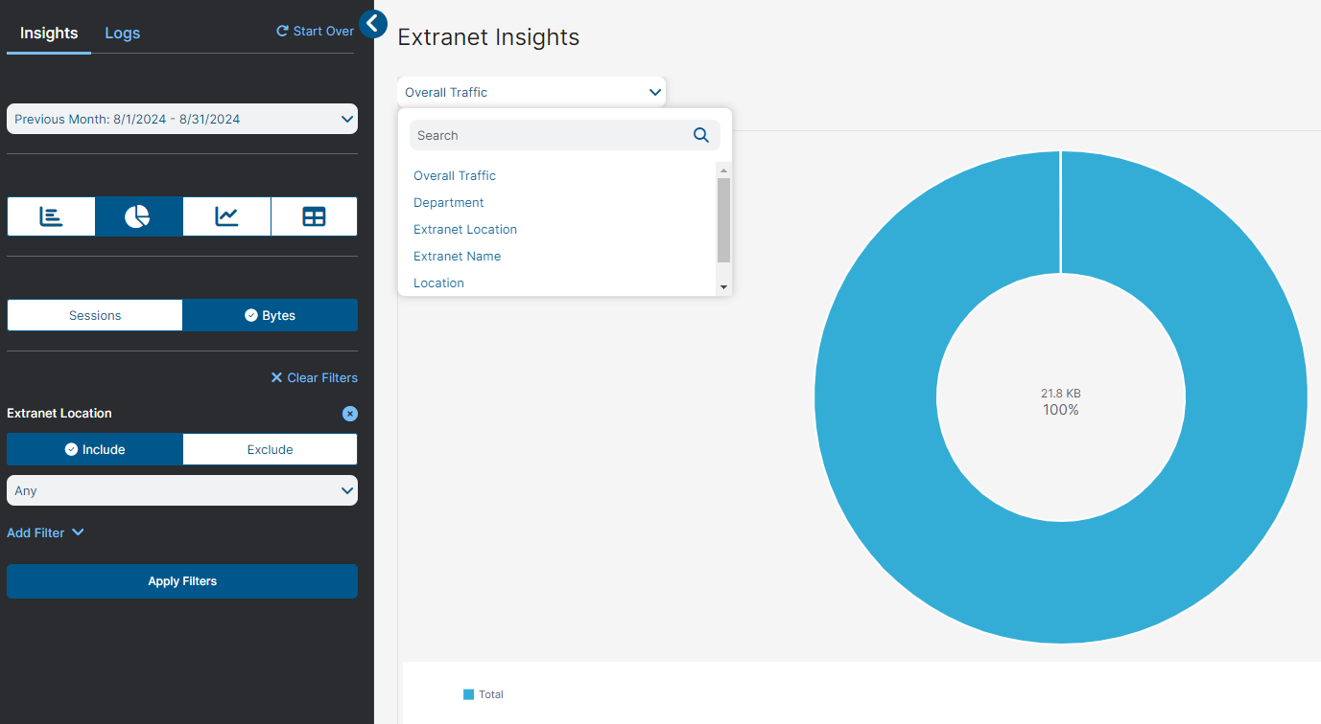
ZIA Extranet Insights
Greater visibility into each partner traffic.
Ability to generate reports and analyze the traffic trends
Granular visibility into logs, per partner , per location

Slide 66
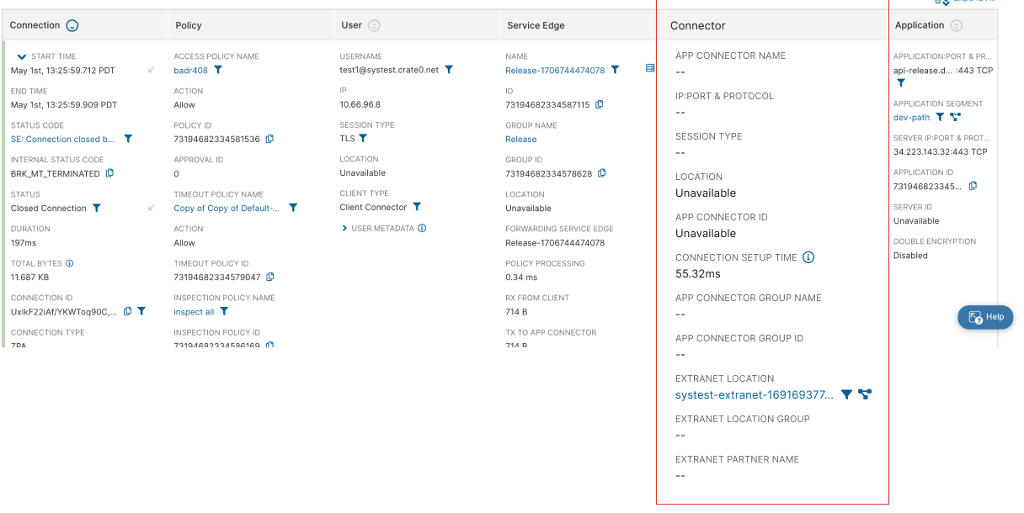
ZPA Diagnostic

Slide 67
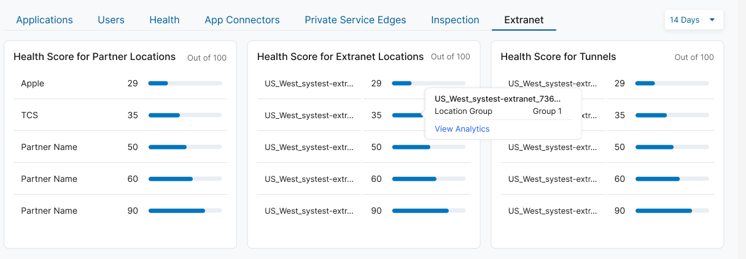
ZPA Extranet Dashboard

Slide 68
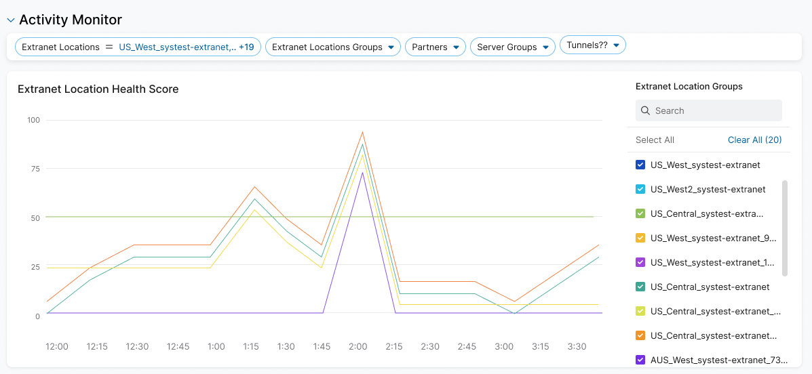
ZPA Extranet Dashboard

Slide 69
Thank You

